Slide 1
RFSoC RF FrontEnd
V1_00

Slide 2
6 Layers(~Xilinx XM500 Design)
GND
PP
RF Signal
Core
GND
PP
GND
Core
Digital Signal
PP
GND

Slide 3
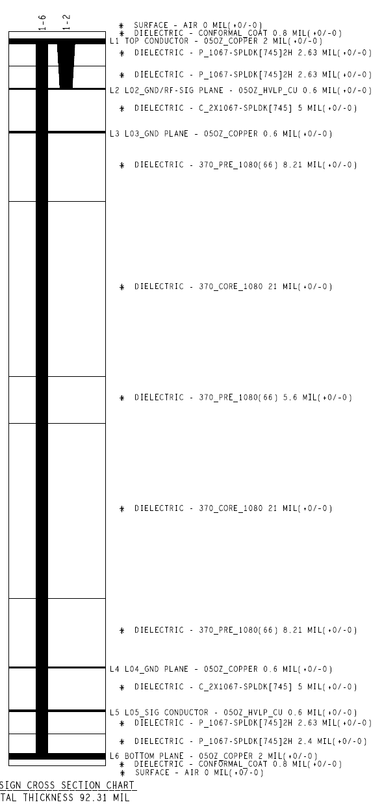
Xilinx XM500 Design

Slide 4
Digital IO
LPAM
ADC Input
BALUN
LPAM
DAC Output
BALUN
Digital IO
PWR

Slide 5
12V
DAC output
JATG
CPLD
XC2C128-7VQG100I
has 80pins
CPLD reamins data after powre down
regulator
7V
use IO port as a CPLD clock
1 digital pin
5 digital pins
TC2-72T+
Eliptical filter
PAT1220-C-9DB-T5
ERA-3SM+
RFMC
SMA
output
LPF
attenuator
-0~31.5dB
Amp
+23dB
(P1dB +13dBm)
T-pad
-9dB
balun
-0.5dB
RF SPDT
SMA
output
HMC545A
QPC7522
HSWA2-30DR+
DAT-31A-PP+
or total 13dB attenuator?

Slide 6
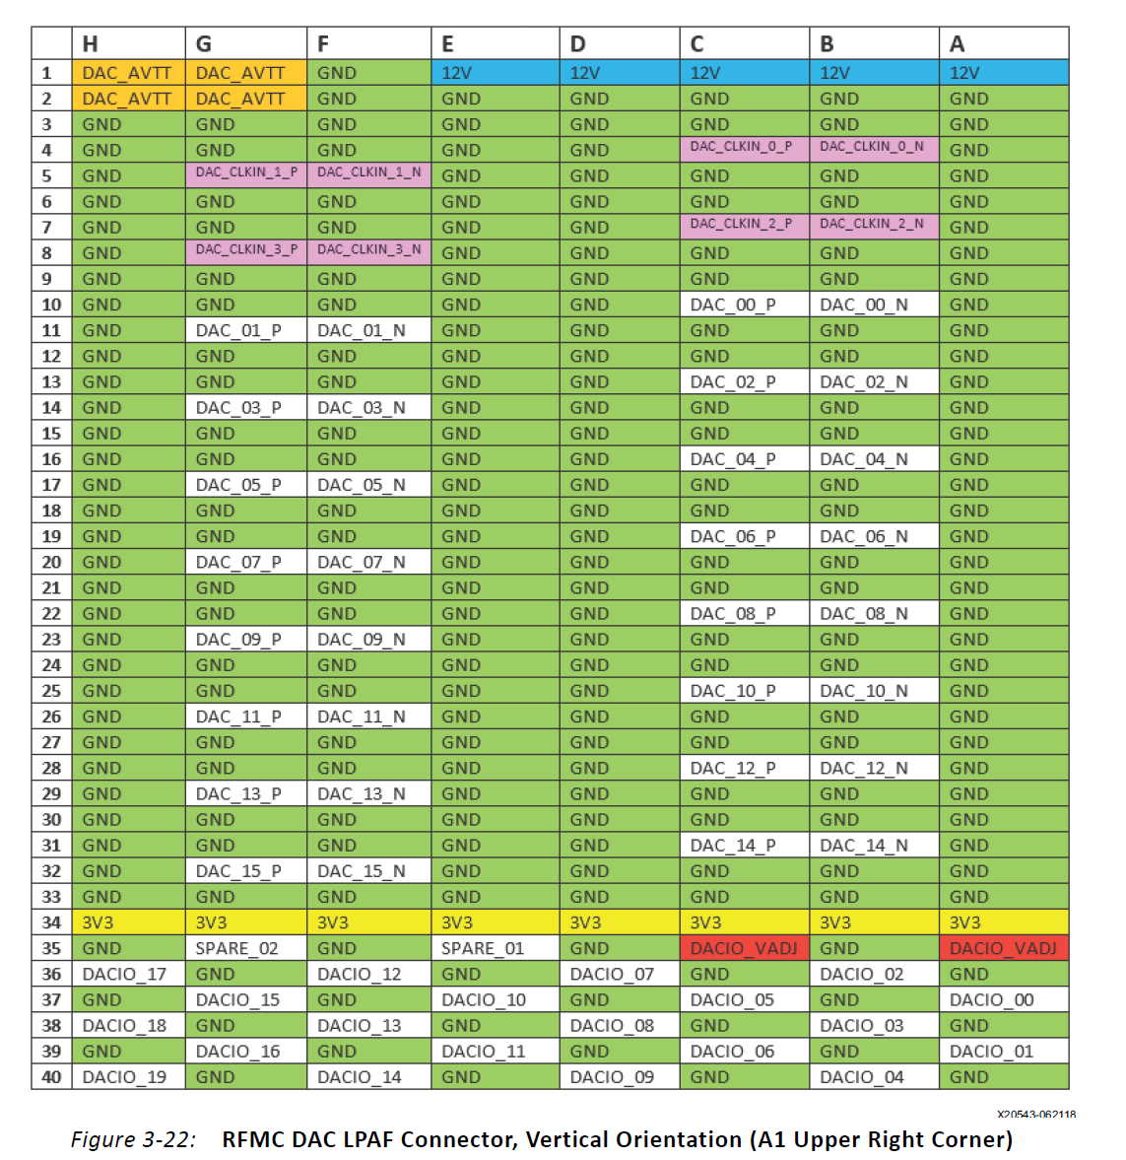
8ns resolution

Slide 7
